Slide 1
Predictive Modeling Project
Classification of Risk that would be faced by different customers for an insurance company
Team -1
Ankit Agrawal
Jessica McGrinder
Praveen Gupta Sanka
Seshi Saraswathi

Slide 2
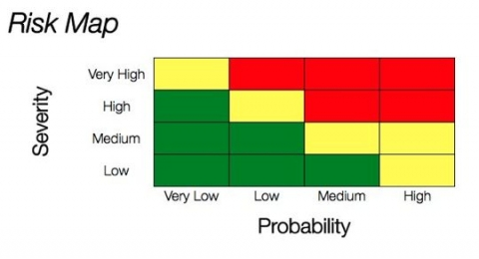


Business Case
Objectives:
Insurance company need prediction model to classify the risk
Less numbers of question to be asked from the customer
Less time required by the customer to fill it
*Picture for illustration from google images

Slide 3
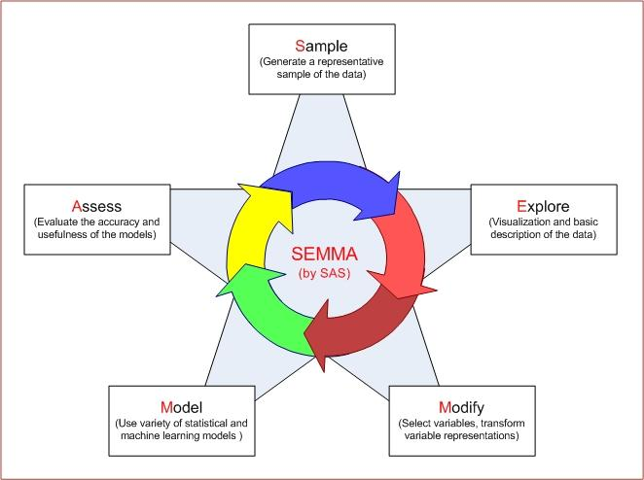
SEMMA Approach
Sample
Explore
Modify
Model
Analyze / Assess the model
*Picture for illustration from google images

Slide 4
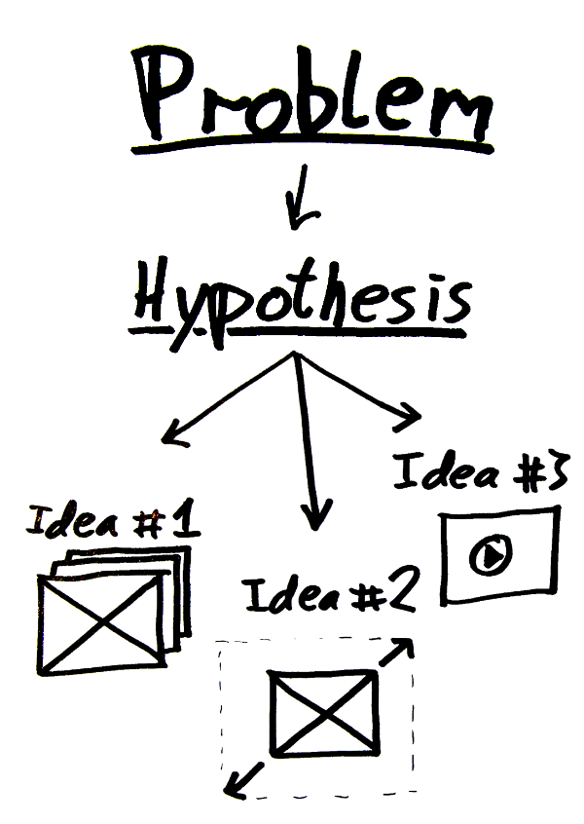

Hypothesis
Factors which could affect the risk of a person’s insurance policy
Age
Height
Weight
Type of work
Medical Illness / Genetic Disorder
Insurance Product being opted
Gender
*Picture for illustration from google images

Slide 5

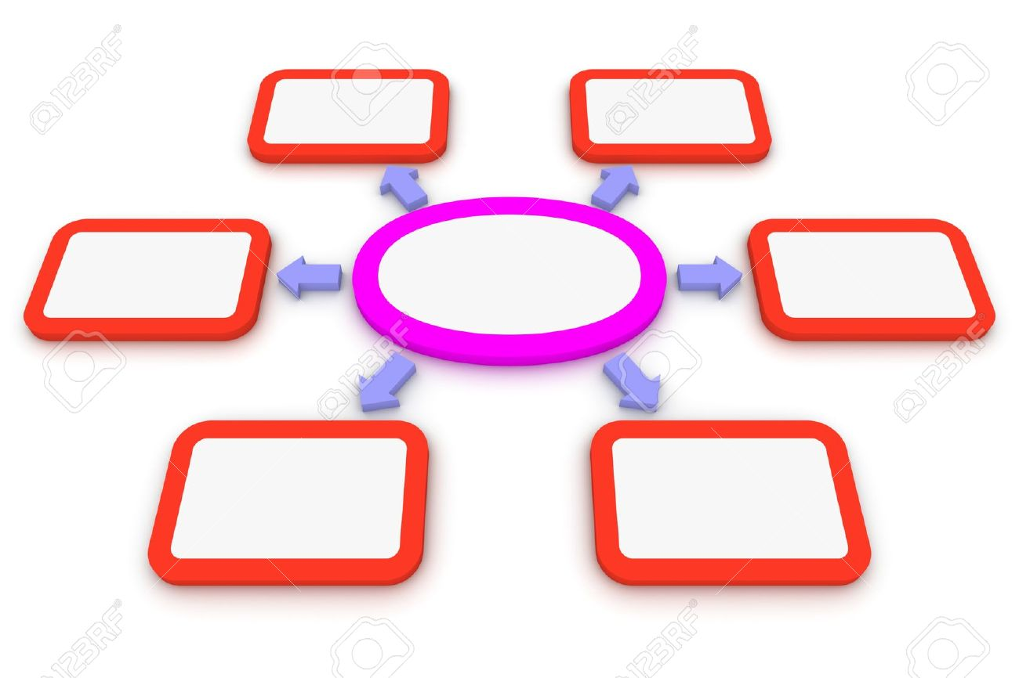
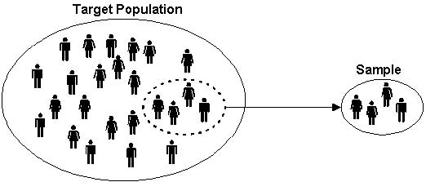

Sample
Data Set of an Insurance company from Kaggle
Number of records in data set = 59,382
Target = Classify (or) Rate from ‘1 – 8’ based on the input features

Slide 6
Features
Variable | Description
Id | A unique identifier associated with an application.
Product_Info_1-7 | A set of normalized variables relating to the product applied for
Age | Normalized age of applicant
Ht | Normalized height of applicant
Wt | Normalized weight of applicant
BMI | Normalized BMI of applicant
Employment_Info_1-6 | A set of normalized variables relating to the employment history of the applicant.
InsuredInfo_1-6 | A set of normalized variables providing information about the applicant.
Insurance_History_1-9 | A set of normalized variables relating to the insurance history of the applicant.
Family_Hist_1-5 | A set of normalized variables relating to the family history of the applicant.
Medical_History_1-41 | A set of normalized variables relating to the medical history of the applicant.
Medical_Keyword_1-48 | A set of dummy variables relating to the presence of/absence of a medical keyword being associated with the application.
Response | This is the target variable, an ordinal variable relating to the final decision associated with an application

Slide 7
Data Exploration
Hypothesized features Vs Actual Features
Hypothesized
(1+) (6)
Actual
(5)

Slide 8
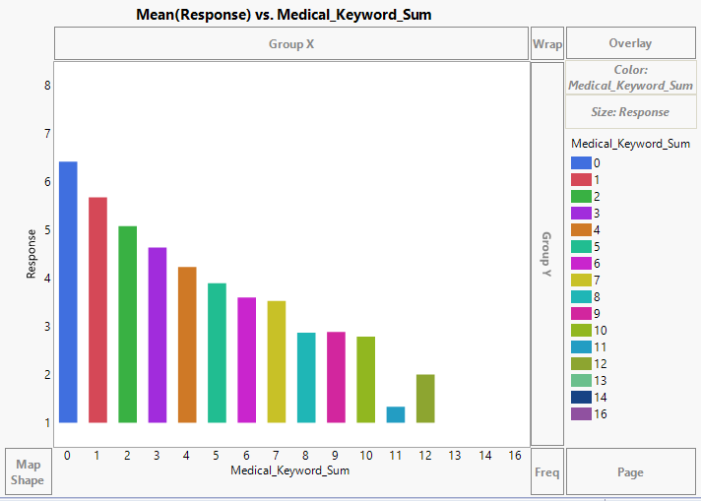
Data Exploration
Findings 1
Risk(target variable vs medical illness)
Lower the previous medical complication, lower is the risk.
Response 1 is the highest risk & 8 is the lowest risk.
Snap shot

Slide 9
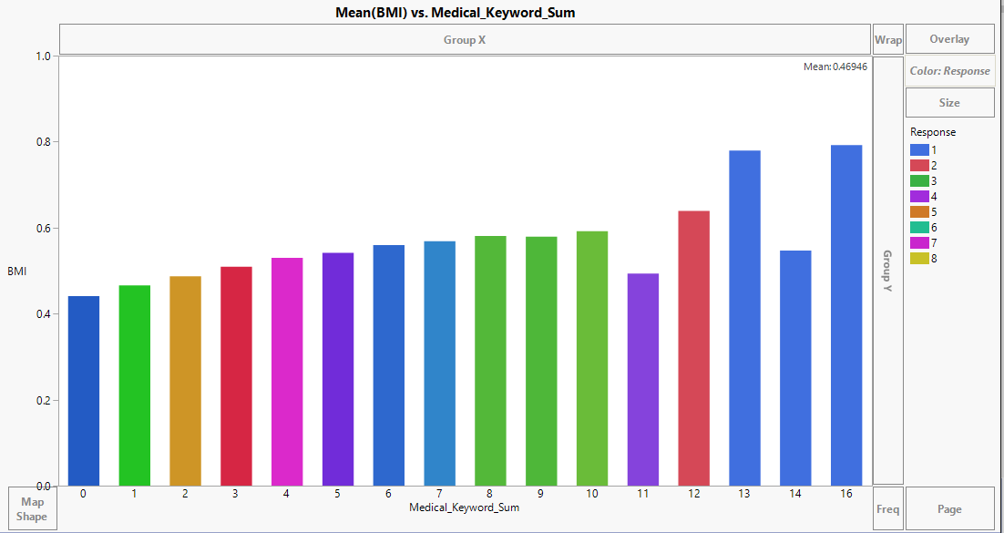
Data Exploration
Findings 2
BMI vs Medical illness
Generally, the higher the BMI greater is the risk
But if BMI is too low & person does not have any medical history is also a high risk as they may be may not be able to resist any virus or germs.

Slide 10
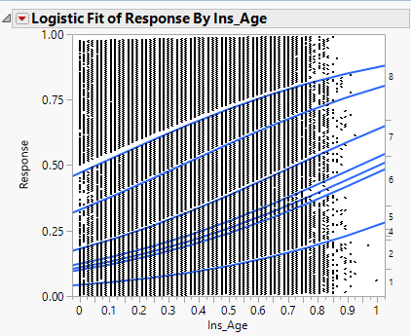
Data Exploration
Findings 3
Snap shot

Slide 11
Explore Missing Values
Missing Values higher in:
Continuous Variable
Customers/Users are not willing to enter the data when asked to enter some numbers/text
Medical History
Avoid for the fear or rejection or high premium rates due to disease prone, drug addicted or long term illness.
Family History
They may not aware of the family history or not want to disclose it.
Employment information
Avoid to declare the type of occupation which may relate to risk like hazardous condition, expose to radioactive substance or un-employment period.

Slide 12
Explore Missing Values
Though the number of feature categories are less, there are many features created under each category
As the number of features increase, probability that number of missing values would increase. Observed lot of missing values
<Missing Data Pattern>

Slide 13
Strategy adopted for Missing Values
<Snapshot of Excel Analysis)

Slide 14
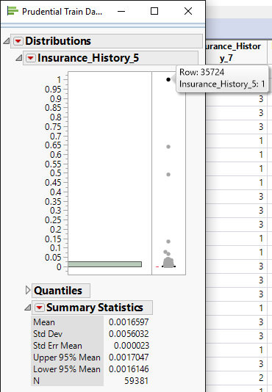
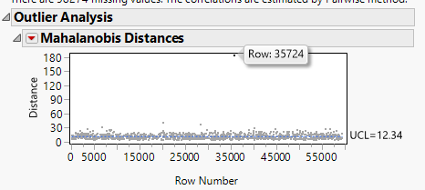
Explore Outliers
Continuous and Categorical
Methods followed for identification of continuous features
Observations outside the whiskers in frequency plot
Quantile range outliers
Mahalanobis
Have added to compare this point. It is an actual typo or classified error. May be a fake entry by some one. (ROW NO 35724), So will delete it
Methods followed for identification of Categorical features
Observation in the frequency distribution plot

Slide 15
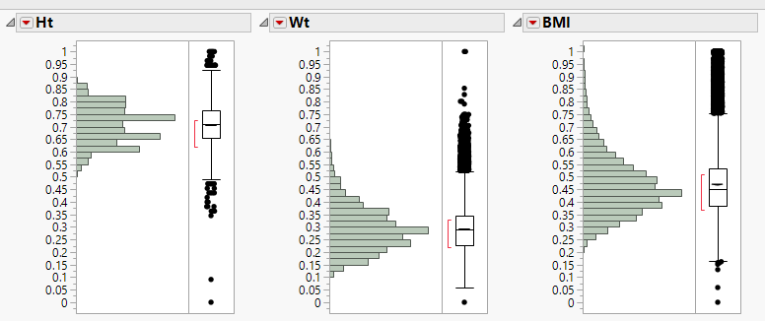
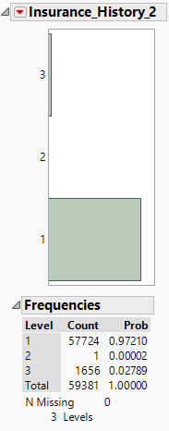
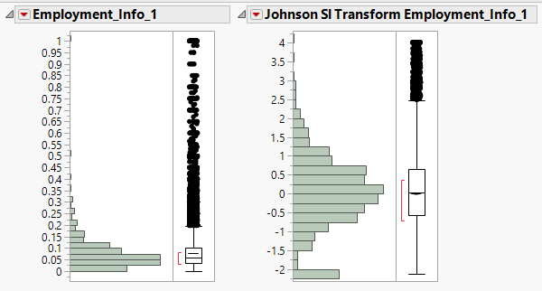
Explore Outliers
Inferences taken :
Could be data entry mistake-Insurance History
Realistic
People may have exceptional Height, Weight & BMI
transformations

Slide 16
Explore Outliers
Analysis Done.
From Excel analysis sheet
Check insurance company online

Slide 17
Data Modification
Feature reengineering
Stressing on analyzing rather on running the model for long period
High Analysis vs Processing Trade off
Actions taken on Outliers and Missing values

Slide 18
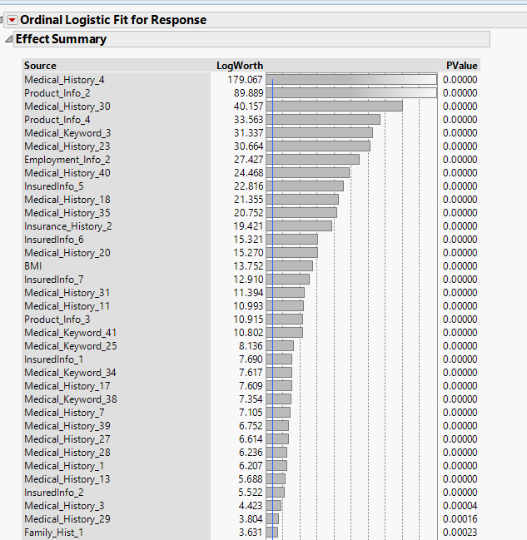
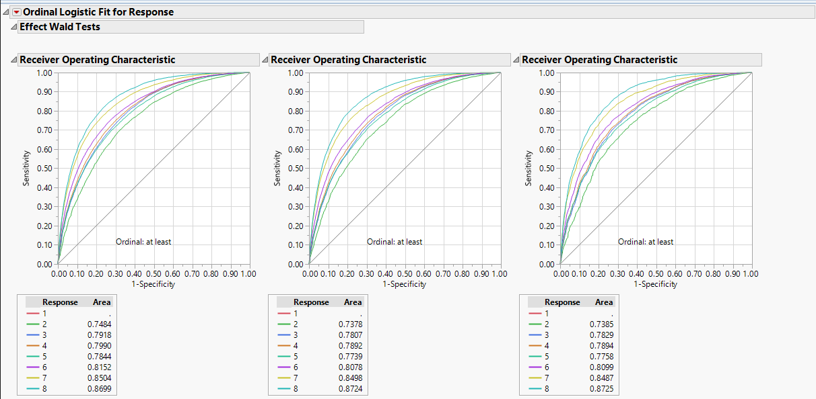
Model Creation
Partition / Decision Tree
Ordinal Logistic

Slide 19
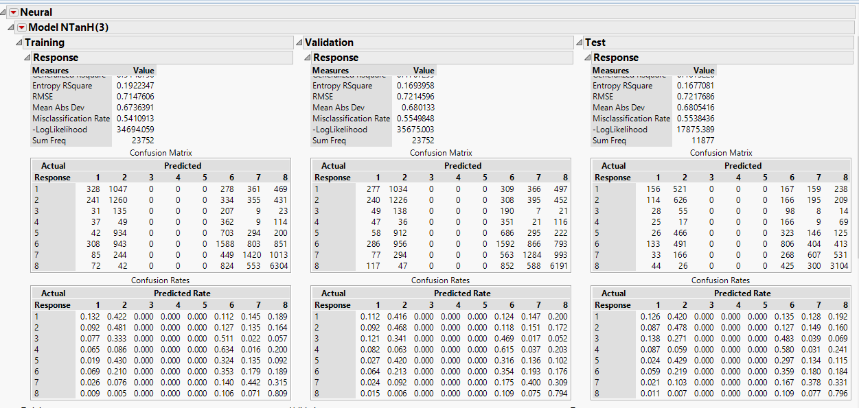
Model Comparison
R – Square
ROC/AUC
Misclassification matrix is not possible as it would be for binary

Slide 20
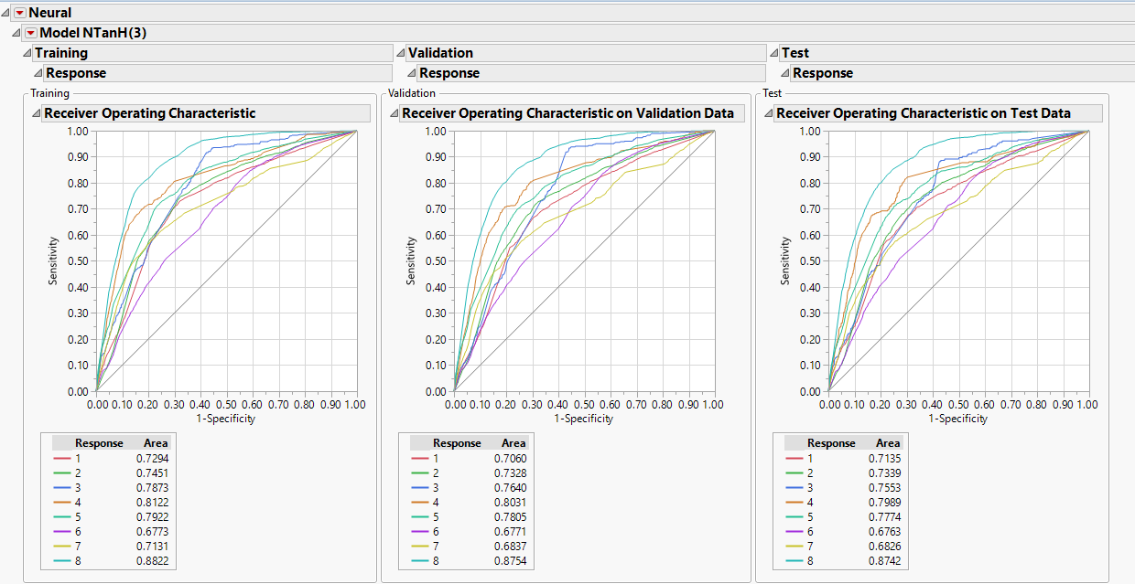

Slide 21
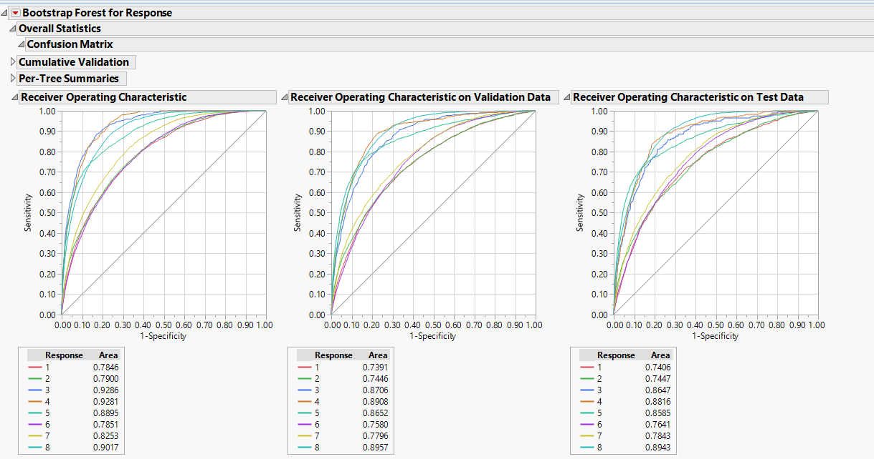

Slide 22
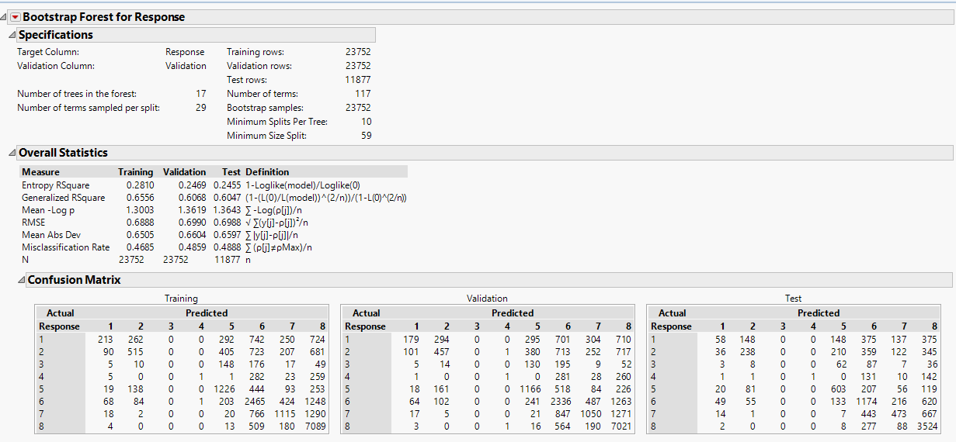

Slide 23
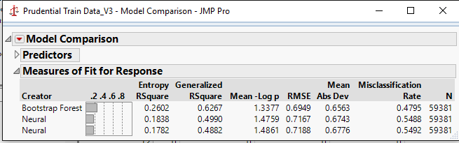
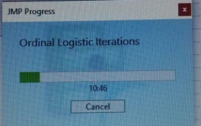
Conclusions
Actions taken on Outliers and Missing values:
Provide Radio buttons & use categorical function.

